Slide 1
Dead line to summited template is 1st Nov 2020
What is your team’s service, Please describe in short
[Sample]
1) We will provide autonomous drone flight service to search victims after Tsunami attacks. A drone is controlled by onboard computer with high accuracy GNSS, fly around search area autonomously. AI will be used image analysis, recognition to detect victims, evacuees, then send message with location and time information and detected image to rescue center.
2) We will provide effective EWS message distributions to remote, less infrastructure area. Satellite based EWS will be used and siren systems and long range LPWA link will compliment for location where satellite signal cannot reach. Once the satellite signal is received siren system and/or LPWA base station, the siren and LPWA device are activated and start sounding, broadcasting EWS message.
What is unique, strong point on your team’s service comparing with existing other services?
1)We will use QZSS MADOCA PPP for high accuracy positioning. Since it doesn’t request CORS nearby, even if Tsunami flash out CORS in damaged coast area, our service can work
2) Our service can cover remote area, and multiple ways can reach local people with higher probability for secure, smooth evacuation.
What is your special request or discussion with the Experts from mentor / date/time for video call. (optional )
1)
2)

Slide 2
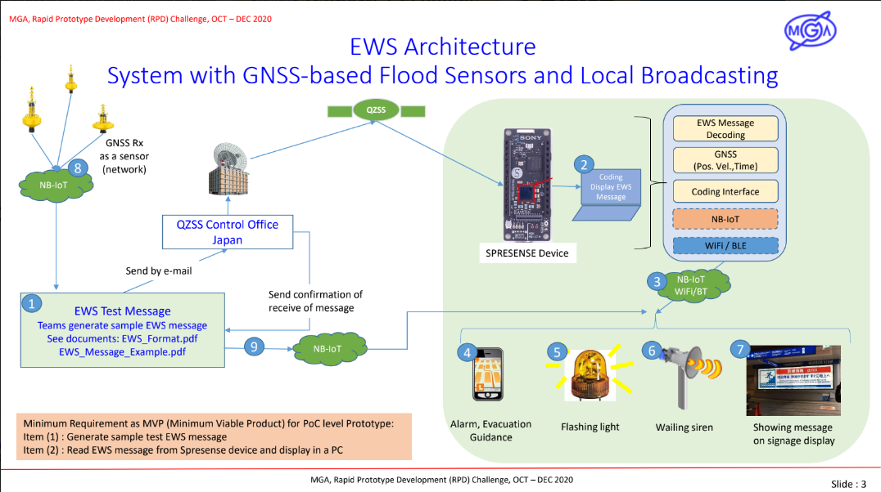

Slide 3
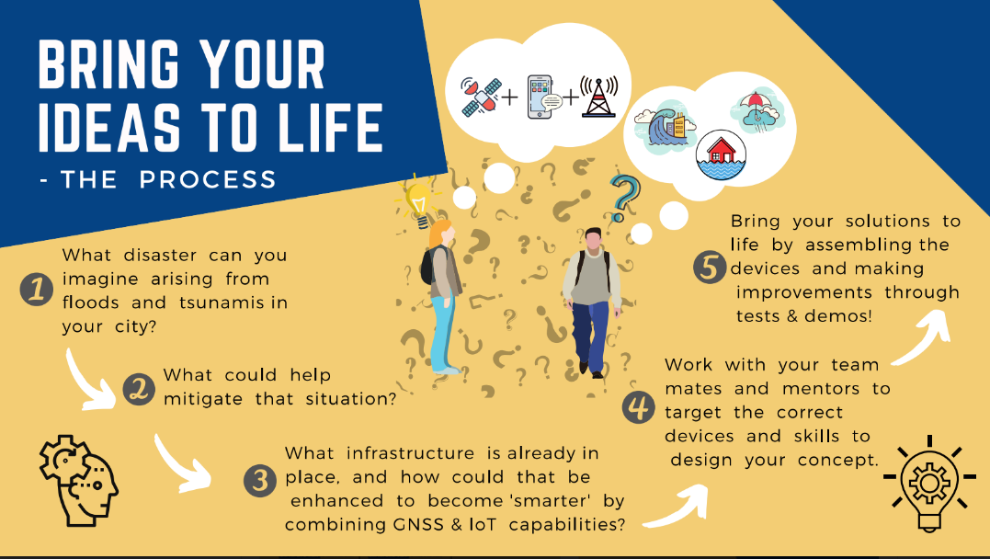

Slide 4
